Slide 1
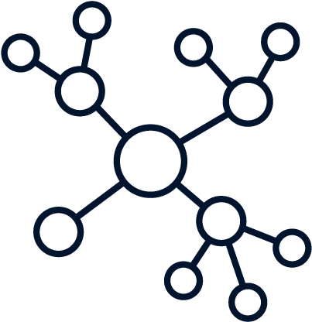
Explainable AI for Estimating Pathogenicity of Genetic Variants Using Large-Scale Knowledge Graphs
Shuya Abe, Shinichiro Tago , Kazuaki Yokoyama and Masaru Fuji
11.19.24
Final Paper Exploratory Data Analysis:
Daniel Gutierrez
CAP5610
Professor Ananda M. Mondal

Slide 2
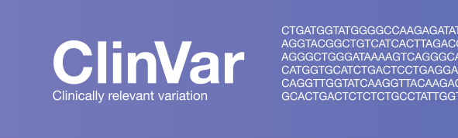
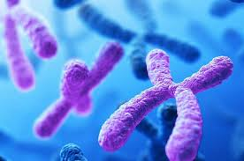
Omics Data
Omics:
ClinVar: Phenomic/Genomic
Summarized Genomic data that includes clinical phenotypes, interpretations, and descriptions for SNV’s
DbNSFP: Genomic
Genomic data that includes identification for single nucleotide variants and scores for genomic deletions and mutations
Also includes scores for the impact of a variant on protein function and synthesis

Slide 3
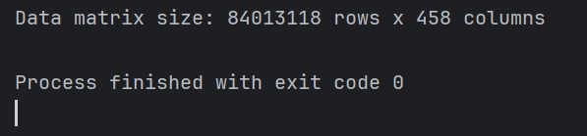
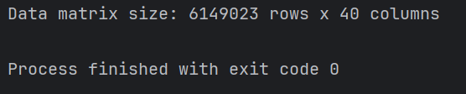
Raw Data Matrix
ClinVar
Data Matrix Size: 6149023 rows x 40 columns
273 MB .gz file(compressed 2.35 GB .txt file)
DbNSFP
Multiple variant files separated by chromosome number. Combined into a single dataset
Data matrix size: 84013118 rows x 458 columns
36.2 GB .gz file(compressed 202 GB .csv file)

Slide 4
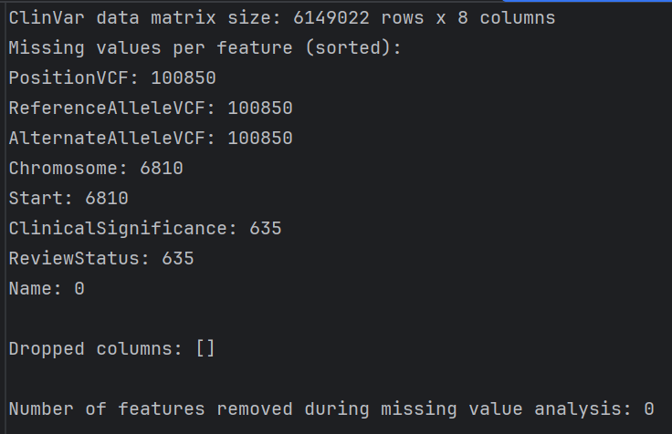
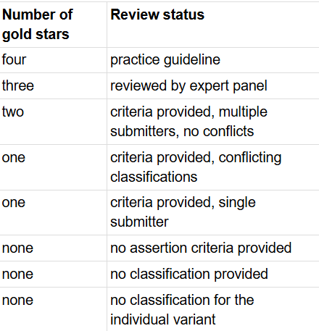
ClinVar EDA
Most of the columns in Clinvar are index or metadata features. Those not used to link Clinvar samples to Dbnsfp samples were removed (32 columns).
ex) LastEvaluated, GeneID, OtherID, etc.
Features Removed (>=80% with ‘-’,’na’,’-1’): none
The features used to link ClinVar to Dbnsfp:
PositionVCF, ReferenceAlleleVCF, AlternativeAlleleVCF, Chromosome
ClinicalSignificance will serve as the class labels for Pathogenicity
Pathogenic/Benign
Exclude “Likely”,”Uncertain” Samples
ReviewStatus will be considered later on for further sample selection criteria

Slide 5
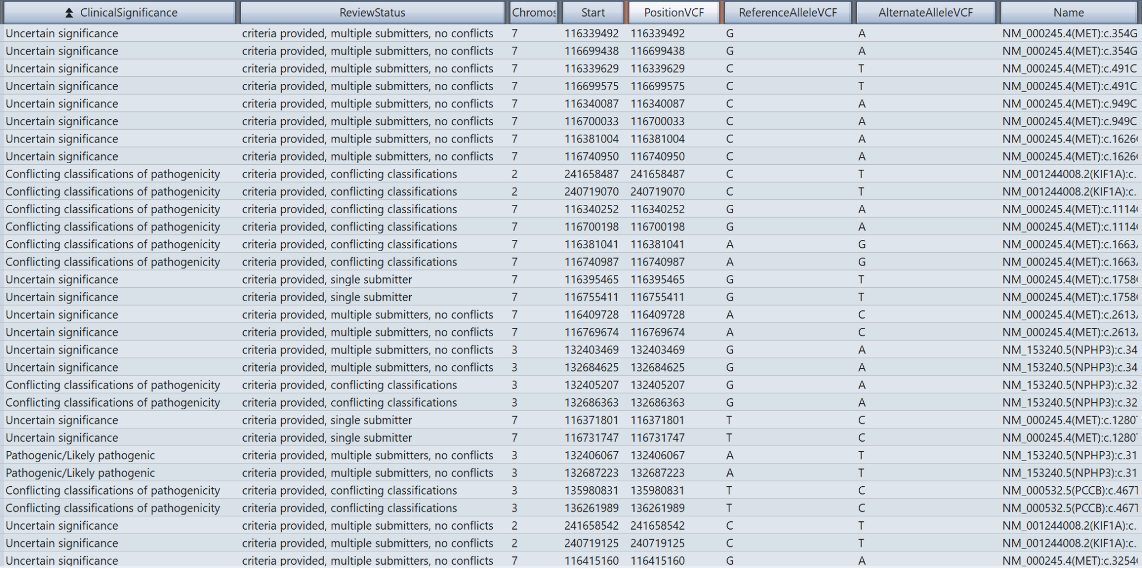
Filtered ClinVar Sample

Slide 6
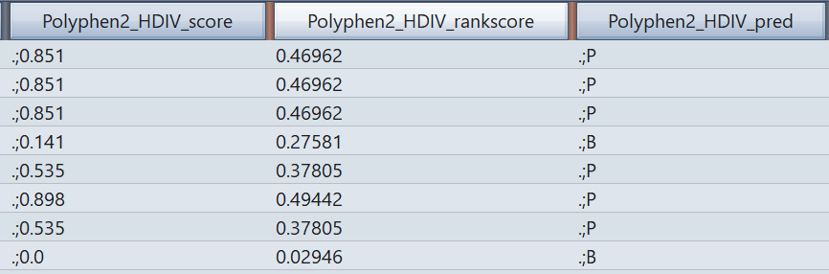
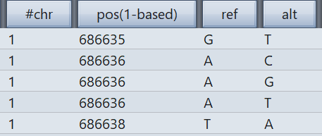
DbNSFP Filtering
Similarly to ClinVar, metadata and index columns were filtered out based on context from the readme
For each algorithm represented in the dataset, there was at least a raw score, rank score, and prediction
Rank Score is a normalized output that computes the ratio of the sample’s rank over the entire dataset for that algorithm
Rank Score usually has a scale of [0,1] with 1 being closest to a behavior that can indicate pathogenicity
Problems with Parsing Raw Scores:
Each column uses different indicators for missing values
Many samples have multiple entries for one column, usually surrounded by a semicolon
The features used to link ClinVar to Dbnsfp:
Chr, pos(1-based), ref, alt

Slide 7
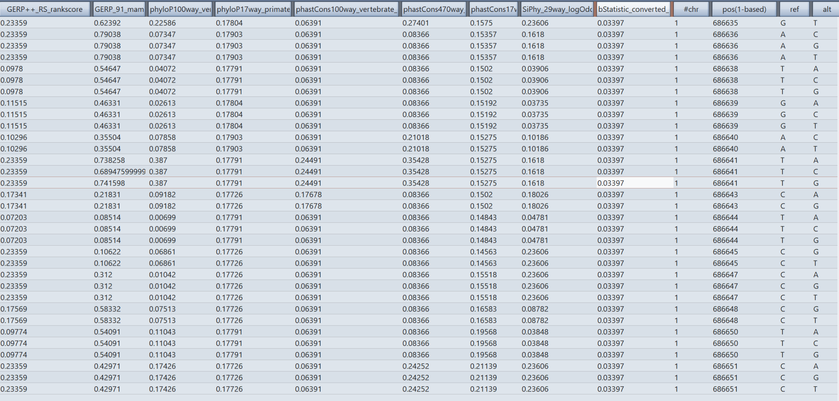
Filtered DbNSFP Sample

Slide 8
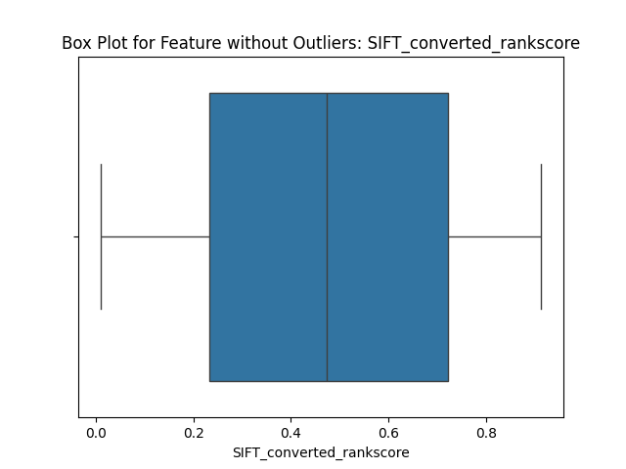
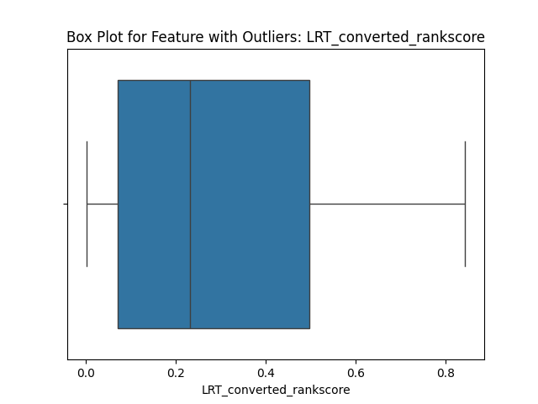
DbNSFP Subset
There still a need to complete a full EDA on the complete filtered dbnsfp dataset before merging with clinvar and use in ML
Limited EDA on DbNSFP on first 10,000 samples
Number of features removed due to missing values(>=80%): 3
EVE_rankscore: 10,000
phyloP470way_mammalian_rankscore: 10,000
LINSIGHT_rankscore: 8610
Number of samples removed during outlier analysis: 7987
integrated_fitCons_rankscore: 1989

Slide 9
Clean Data Matrix
Clinvar
Cleaned ClinVar data matrix size: 6149022 rows x 8 columns
DbNSFP Subset
Cleaned DbNSFP subset: 2013 rows x 59 columns

